Slide 1
Evolution and TDL IGGI Game Design Part II Simon Lucas (note: the n-tuple slides are bonus material, you probably won’t use these)

Slide 2
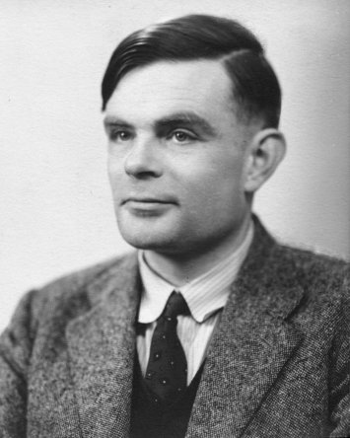
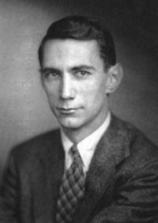
Aims
Learning to play games
A grand challenge identified by the pioneers in our field
Provide insights into when each method is likely to work best
Notes:
This tutorial provides a practical guide to the main techniques involved in learning to play games. The emphasis will be on systems that are able to learn games autonomously, that is, without any human intervention. I’ll provide insights into which methods work best in which situations, and on how the detailed design choices can make the difference between success and failure. During the tutorial I will demonstrate temporal difference learning and evolution in action. I will assume familiarity with Neural Networks (in particular, Multi-Layer Perceptrons and Error Back-Propagation) and the basics of evolutionary computation, that is: evaluation, selection, variation and reproduction).

Slide 3
My Favourite Neural Net (possibly with more inputs)

Slide 4
My Favourite Evolutionary Algorithm
Random Mutation Hill Climber
(1+1) ES

Slide 5
Overview
Architecture (action selector v. value function)
Learning algorithm (Evolution v. Temporal Difference Learning)
Function approximation method
E.g. MLP or Table Function
Interpolated tables
Sample game: Othello
Notes:
Here are the main points of the tutorial. We’ll look at the main types of architecture: action selector versus value function. We’ll consider the two main approaches to learning: evolution, and temporal difference learning. For most non-trivial games it is necessary to perform some type of function approximation: here we’ll consider multi-layer perceptrons and various types of table function. A learner can only learn on the basis of the information provided to it. I’ll show how information theory can be used to place bounds on the maximum number of bits of information that can be learned per game played. During the tutorial we shall look at various games or control problems, including mountain car, Othello, and Ms. Pac-Man.

Slide 6
Architecture
Where does the computational intelligence fit in to a game playing agent?
Two main choices
Value function
E.g. [TD-Gammon], [Neuro-Gammon], [Blondie]
Action selector
[NERO], [MENACE]
We’ll see how this works in a simple grid world
Notes:
We’ll begin by looking at the main classes of architecture. An agent perceives the world through some real or virtual sensors. These are fed to the inputs of a function approximator. There are two main ways this can be configured: either as a value function or as an action selector. In the value function approach, the agent projects the current state of the game to a set of possible future states, by applying a set of actions to a model of the game or system. The value function takes as input a game state, and produces a single value as output for each state. The agent selects the action that leads to the highest value state (as judged by the value function).
In the case of an action selector, it takes only the current state of the game, and directly outputs the action to take. The interpretation of the outputs will depend on the nature of the game. For example, when using this approach for a board game, the outputs of the function approximator will be continuous values, but the move selected could be the legal move with the highest associated output. On the other hand, for a car racing game there might two outputs that are directly interpreted as the accelerator and the steering angle.

Slide 7
Action Selector
Maps observed current game state to desired action
Multiple output F.A.
For
No need for internal game model
Fast operation when trained
Against
More training iterations needed (more parameters to set)
May need filtering to produce legal actions
Good for real-time control problems / games
E.g. Car Racing
Output Filter
Function
Approximator
Feature
Extraction
Game State
Notes:
Let’s look in some more detail at the properties of an action selector. On the plus side there is no need for an internal model of the game, and once trained it offers fast operation. Against this, it is slower to train as it has more parameters to set than an equivalent value function. Also, some post processing may be required in order to guarantee actions which are legal.

Slide 8
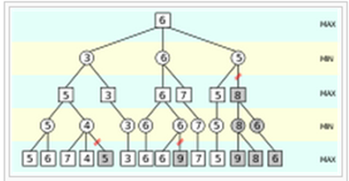
State Value Function
Hypothetically apply possible actions to current state to generate set of possible future states
Evaluate these using value function
Pick the action that leads to the most favourable state
For
Easy to apply, learns relatively quickly
Against
Need a model of the system
Good for classic games e.g. Othello
Notes:
To reiterate, the state value function works by applying a set of possible actions to the current game state to generate a set of possible future states. These states are then evaluated with the value function. The action is chosen that leads to the state with the highest value. Since the system has only a single output, the system typically has fewer parameters than an action selector, and learns relatively quickly. On the negative side, a model of the system is required in order to project forward in time. The approach is very flexible, and stronger players can often be generated by simply projecting further forward in time, though at the expense of greater CPU time during training and operation.

Slide 9
State Value Diagram
Game state projected to possible future states
These are then evaluated
Choose action that leads to best value
Single output F.A.
Func.
Approx.
Func.
Approx.
Func.
Approx.
Feature
Extraction
Feature
Extraction
Feature
Extraction
Game State
(t+1, a1)
Game State
(t+1, a2)
Game State
(t+1, an)
Game State (t)
Notes:
This diagram shows a block diagram of a value function being used to play a game.
The game state at time t is projected to future states at time t+1, in the diagram these are shown as the result of taking actions a1, a2, and a_n.
Each game state then goes in turn through the exact same feature extractor and function approximator being
operated as a value function.
The function approximator has a single output indicating the value of that state. The chosen action is the one that leads to
the highest output.

Slide 10
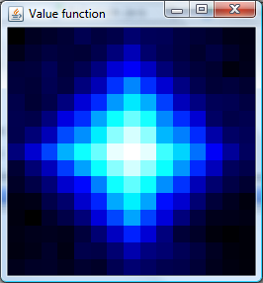
Grid World
n x n grid
Green disc: goal state
Red disc: current state
Actions: up, down, left, right
Red circles: possible next states
Example uses 15 x 15 grid
Notes:
To clarify these approaches, let’s consider a simple grid world problem.
The aim is for the agent (the red disc) to find the goal (the green disc in the centre).
The grid is toroidal, and in each state there are four possible actions: up, down, left and right.
Let’s see now how to address this problem with a state value function, and with an action selector.

Slide 11

Grid World: State Value Approach
State value: consider the four states reachable from the current state by the set of possible actions
choose action that leads to highest value state
Notes:
For the state value approach, each state (that is, each grid square) has an associated value. To select an action, the four possible next states are considered (each shown by a red circle). The bold arrow shows the selected action, which is the one that leads to the highest value state (shown by the lighter shade of blue).
[note: ideally the actions should be animated in turn]

Slide 12


Grid World: Action Selection Approach
State-Action Value
Take the action that has the highest value given the current state
TDL when applied to learn state-action values is often called Q-learning
Notes:
For the action selection approach, note how each grid square now has four values in it. These are the values associated with taking each possible action in that state. Note that there was no projection to future states.
The diagram shows the action with the highest value (lighter shade) being selected.
In this case, there are four times as many parameters to learn compared with the state value approach.
When using function approximators the relationship between the respective number of parameters will not be so straightforward, but learning to take actions directly is generally a harder task than learning only the values of states.

Slide 13
Learning Algorithms
Next we’ll look at the main algorithms for learning the parameters of a game-playing system
These are temporal difference learning (TDL) and Evolution (or Co-Evolution)
Both can learn to play games given no expert knowledge
Also see: [PREF-LEARNING-GAMES]
Focus on making correct moves (like evolution) but from game-play (like TDL)
Notes:
Next we’ll study the main algorithms for learning the parameters of a game-playing system. These are temporal difference learning (TDL) and Evolution (or Co-Evolution). Although there are many possible algorithms to use, many of them can be placed into one of these categories.

Slide 14
Temporal Difference Learning (TDL)
Can learn by self-play, during game-play:
Learns: successive states should have similar values
Essential to have some reward structure
This may follow directly from the game
Uses information readily available:
current observable game-state
May learn faster than evolution; may be less robust.
Function approximator must be trainable
i.e. can calculate:
Notes:
In standard temporal difference learning an agent learns by playing the game against itself. In the case of a single player game it takes actions in the game environment.
It is essential to have some kind of reward structure, but this will often follow directly from the game. For example, when learning to play a board game, a reward can be given at the end of each game depending on the result (win, lose, or draw). TDL also learns during game play. It learns that consecutive states should have similar values.
As a result of using more information, TDL often learns faster than evolution, but it may be less robust.
One limitation of TDL is that the value function must be trainable – this usually means that it must be differentiable.

Slide 15
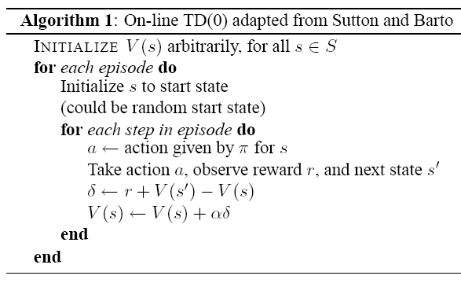
Sample TDL Algorithm: TD(0) (adapted from [RL]) typical alpha: 0.1 π: policy; choose rand move 10% of time else choose action leading to best state
Notes:
Here we see the most basic temporal difference learning algorithm called TD(0). This
is an instance of the more general TD-Lambda class of algorithm, the difference being
that the lambda version keeps an eligibility trace of states to update.
The aim of the algorithm is to learn a state value function V(s). A typical policy while learning
is to choose the action that leads to the best subsequent state, but to take random moves 10% of the time
to ensure that the agent makes a reasonable exploration of the state space. At the outset V(s) may
be set to random values or to some uniform value such as zero. This often depends on the function
approximation architecture. For example, a table function might be zeroed, whereas this is not an option
for an MLP as the lack of gradient implied by that would ensure that no learning took place.
Each episode starts in a specially chosen or random start state.
An episode consists of a set of steps. At each step the agent chooses an action according to
the policy, observes a reward r, and transitions from the current state s to the next state s’.
The update term delta is calculated as the reward plus the difference in values between the two states.
Hence, in the absence of any reward the effect is to make V(s) closer to V(s’).
The magic of TDL is that to begin with, the reward-free updates are meaningless, since they just
make one nonsense value more similar to another nonsense value.
But over time a boot-strapping process occurs, and the values approach the expected reward for each state.

Slide 16
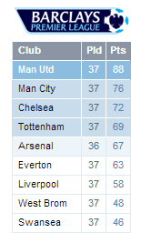
The essence of an Evolutionary Algorithm
Create an initial random population of solutions
Repeat until satisfied or bored
Evaluate fitness
E.g. run a game playing tournament
This makes it coevolution
Select parents
Breed offspring as variations of parents
Can use mutation, crossover etc
Replace weaker members with new offspring
Robust but slow: only log_2(N) bits of information per generation

Slide 17
Co-Evolution: Some Notes
Aims for an arms race
Constant improvement through successive generations
May learn slowly
Typical learning rates: much less than 1 bit per game played
Intransitivity can lead to cycling
“Hall of fame” or other archives can be used to add memory – preserve best solutions from previous generations
See [COEV-INTRANSITIVITIES] for further reading

Slide 18
Grid World: TDL(0), State Values
Example uses 15 x 15 grid
Maximum number of iterations was set to 450 (twice the number of squares on the grid)
The reward structure: -1 everywhere apart from the goal; 0 at the goal
alpha = 0.1, epsilon = 0.1
The diagram shows a successfully learned state value table
SEE DEMO
Notes:
Each episode: start at a random place on grid and take actions according to policy until the goal is reached, or maximum iterations have been reached
Example uses 15 x 15 grid
Maximum number of iterations was set to 450 (twice the number of squares on the grid)
The reward structure: -1 everywhere apart from the goal; 0 at the goal
The diagram shows a successfully learned state value table, with lighter shades of blue indicating more valuable squares

Slide 19
Evolving State Tables
Interesting to make a direct comparison for the grid problem between TDL and evolution
For the fitness function we measure some aspect of the performance
E.g. average number of steps taken per episode given a set of start points
Or number of times goal was found given a fixed number of steps
Notes:
It is interesting to make a direct comparison on the grid problem between TDL and evolution.
For evolution’s fitness function we measure some aspect of the performance.
To give two examples, this could be the average number of steps taken per episode given a set of start points,
or alternatively, the number of times goal was found given a fixed number of steps.

Slide 20
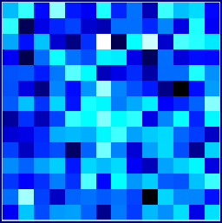
Evolving a State Table for the Grid Problem
This experiment ran for 1000 fitness evaluations
fitness function: average #steps taken over 25 episodes
So 25,000 episodes
used [CMA-ES] – a powerful evolutionary strategy
very poor results (final fitness approx 250)
sample evolved table

Slide 21
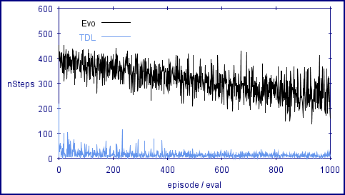
TDL versus Evolution Grid Problem, State Table
TDL greatly outperforms evolution on this experiment
Notes:
[tidy these words up a bit]
TDL greatly outperforms evolution on this experiment.
Also note that each fitness evaluation for evolution is based on the average of 25 episodes.
The graph therefore shows the result of 25,000 episodes for evolution versus only 1000 episodes for TDL.
Evolution makes very disappointing progress on this problem when applied in this way. Each fitness evaluation was the average of 25 episodes, so the graph shows how fitness evolved given 25,000 episodes. On this particular run it was a bit lucky at the end (note how the score drops) but the optimum score for this problem is around eight.

Slide 22
Neuro-Evolution for Pac-Man
Lucas 2005, CIG
Tough and interesting game, went on to be run for many competitions
In screen capture mode from original game and using our simulators
Covered here as an example of how to form a feature vector
And the effects of randomness on evolving game players
Note: (1+1) ES = Random Mutation Hill Climber

Slide 23
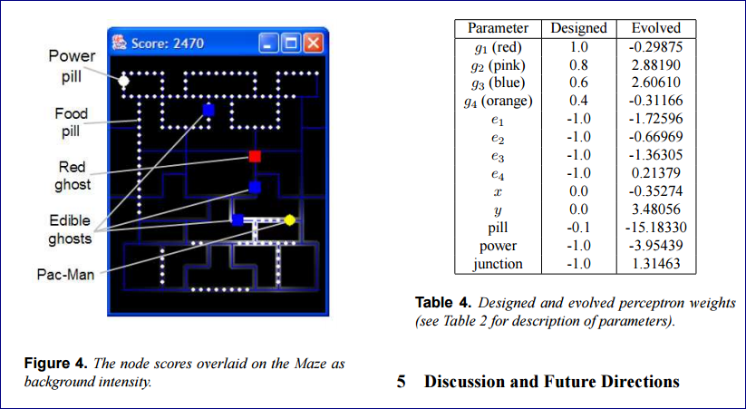
Evolved Weights – full of suprises

Slide 24
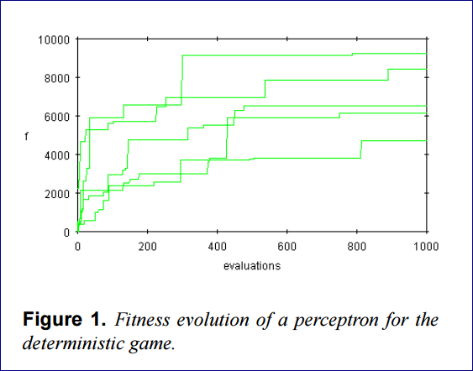
Evolving for Deterministic Game

Slide 25
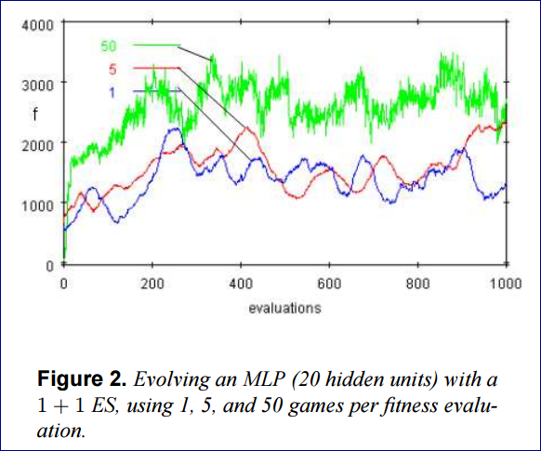
Note the lower scores for non-deterministic version!

Slide 26
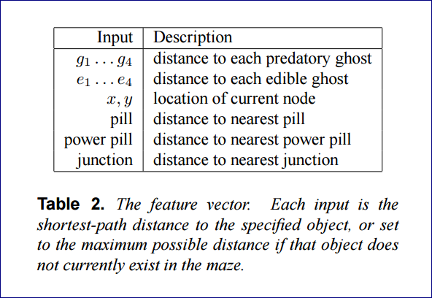
Feature Vector

Slide 27
Pac-Man Competitions Retrospective
Some very clever approaches
MCTS has performed well, but sometimes a lot of engineering goes in to it
See Samothrakis et al, 2011
And more recently Pepels and Winands
My favourite approach, the Probability Propagation approach that won many of the competitions

Slide 28
Function Approximation

Slide 29
Function Approximation
For small games (e.g. OXO) game state is so small that state values can be stored directly in a table
For more complex games this is simply not possible e.g.
Discrete but large (Chess, Go, Othello, Pac-Man)
Continuous (Car Racing, Modern video games)
Therefore necessary to use a function approximation technique e.g.
MLP, Interpolated table, N-Tuple system
Notes:
For small games (such as Grid-World or tic-tac-toe) the game state is so small that state values can be stored directly in a table
For more complex games this is simply not possible e.g.
Discrete but large (Chess, Go, Othello, Pac-Man)
Continuous (Car Racing, Modern video games)
It is therefore necessary to use a function approximation technique.
But which one?

Slide 30
Table-Based Systems
Can be used directly for discrete inputs in the case of small state spaces (e.g. grid-problem from earlier)
Continuous inputs can be discretised
But table size grows exponentially with number of inputs
Naïve is poor for continuous domains
too many flat areas with no gradient
CMAC coding improves this (overlapping tiles)
Even better: use interpolated tables
Generalisation of bilinear interpolation used in image transforms
Notes:
Can be used directly for discrete inputs in the case of small state spaces
Continuous inputs can be discretised
But table size grows exponentially with number of inputs
Naïve is poor for continuous domains
too many flat areas with no gradient
CMAC coding improves this (overlapping tiles)
Even better: use interpolated tables
Generalisation of bilinear interpolation used in image transforms

Slide 31
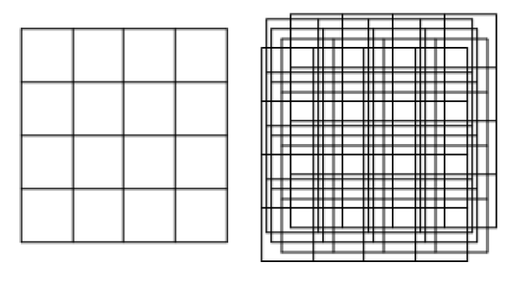
Table Functions for Continuous Inputs Standard (left) versus CMAC (right)
s2
s3
Notes:
This diagram illustrates a state-based controller for a problem with continuous inputs.
The state space has been discretised using the overlaid grid, and after discretisation
can be modelled with a table of values (a bit like we did for the grid problem, except
that was naturally discrete.
A potential problem in the left figure is that the discretisation may be too coarse.
In fact, no matter how much training the system undergoes it will never
be able to distinguish the value of state s1 from state s2.
The right diagram shows a CMAC table. This uses the same underlying tabular
representation of the value function, but uses a set of randomly dithered discretisations.
This allows the state value function to be smoother while using the same amount of memory.

Slide 32
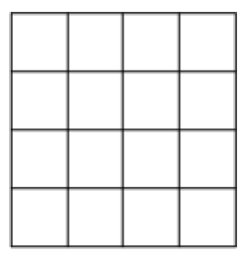


Interpolated Table
Notes:
An alternative technique developed by the author is to use interpolation between the values in a standard
table. Values are stored for each corner point and interpolation is used to calculate values in between.
The easiest method to apply is bi-linear interpolation, but more sophisticated schemes are also possible.

Slide 33
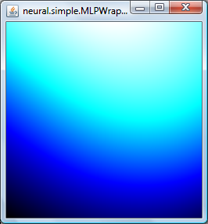
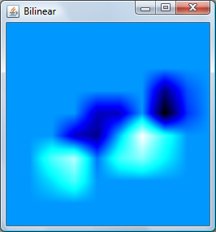
Function Approximator: Adaptation Demo This shows each method after a single presentation of each of six patterns, three positive, three negative. What do you notice?
Notes:
This function approximation adaptation demonstration clearly shows how training an MLP differs fundamentally
from training a table function, or other type of local approximator.
After seeing just one presentation of each of the six points the table functions have not only learned those points, but give neighbouring input points similar values.
In the case of the MLP, after a single pass through the data there is not yet any resemblance to it.

Slide 34
Grid World Results Architecture x Learning Algorithm
Interesting!
The MLP / TDL combination is very poor
Evolution with MLP gets close to TDL performance with N-Linear table, but at much greater computational cost
Results show average cost to goal (lower is better)
Architecture | Evolution (CMA-ES) | TDL(0)
MLP (15 hidden units) | 9.0 | 126.0
Interpolated table (5 x 5) | 11.0 | 8.4
Notes:
This slide summarises the results of the previous few slides.
The table shows the average final score over 10 runs of each setup, and illustrate the dependency between the learning algorithm and the best choice of architecture.
For this problem the best combination is TDL with a table function, but TDL performs very poorly with an MLP.

Slide 35
Function Approximation Summary
The choice of function approximator has a critical impact on the performance that can be achieved
It should be considered in conjunction with the learning algorithm
MLPs or global approximators work well with evolution
Table-based or local approximators work well with TDL
Further reading see: [InterpolatedTables]

Slide 36
Function Approximation and Feature Extraction / Design
One approach is to always use linear function
But pay careful attention to the features
Note: N-Tuple method which we’ll use for Othello takes this approach
Map 64-dimensional board vector to 6561-dimensional N-Tuple features vector

Slide 37
Othello

Slide 38
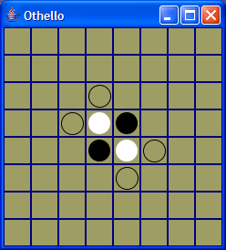
Othello (from initial work done with Thomas Runarsson [CoevTDLOthello])
See
Video
Notes:
We now turn our attention to the game of Othello which presents an interesting learning challenge.
It is a widely known two-player game with simple rules but is currently an unsolved game.
The volatile piece difference makes it an interesting and deceptive game to play.
Players take turns to move and at each turn must capture one or more opponent pieces.
A capture is achieved by when an opponent piece lies on an unbroken line between the
newly placed piece and an existing piece of that player.

Slide 39
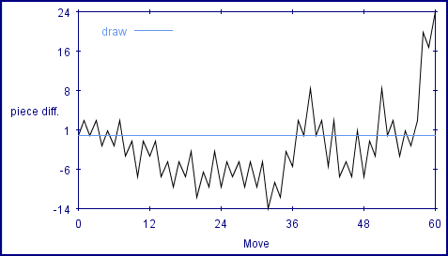
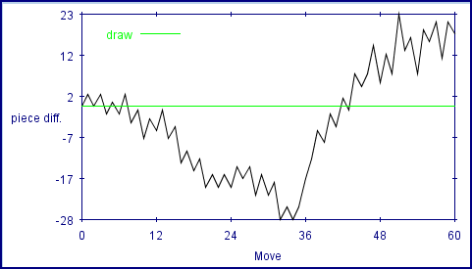
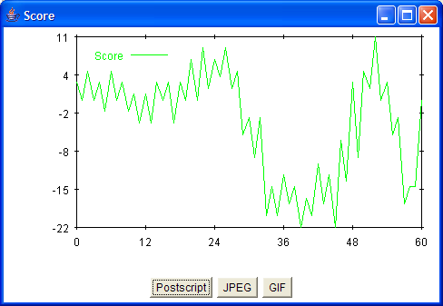

Volatile Piece Difference
move
Move
Notes:
This graph shows a typical encounter between a weak player and a strong player – this is the game from the video clip.
The weak player is playing as white and by our convention we’ll consider each white counter to have a value of -1 and each black counter to have a value of +1.
We can then plot how the piece difference varies with the number of moves made during the game. The weak has a strong piece advantage in the middle but suffers tactically, and if you watch the video clip closely you’ll see that white actually has to miss a turn towards the end of the game.

Slide 40
Othello Value Function Approximation
Unwinds 8 x 8 board as a 64 dimensional input vector
Each element of vector corresponds to a board square
value of +1 (black), 0 (empty), -1 (white)
Approximators include: MLP, P, N-Tuple, Spatial MLP
Single output
Function Approximator
64-element input vector
Notes:
This slide clarifies how a weighted piece counter can act as a value function for Othello.
The board is unwound as a 64-element vector with an element for each corresponding board
square. The element values are set to 1 for a black counter, 0 for an empty square, and -1 for
a white counter. This is called the input vector or board vector.
The current ‘player’ is defined as a 64-element weight vector. The value of the board is defined
as the scalar product of the weight vector with the board vector.

Slide 41
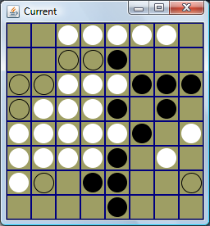
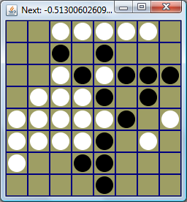
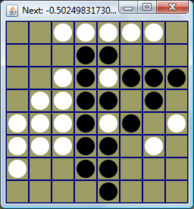
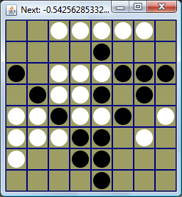
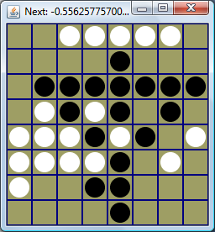
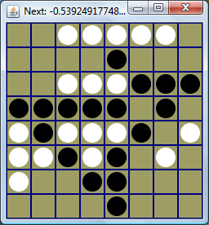
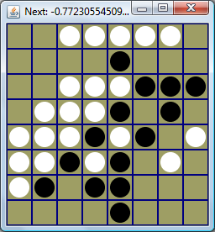
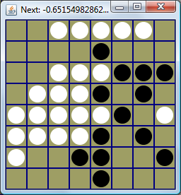
Othello: After-state Value Function
Notes:
This slide illustrates the process of playing Othello with a state value function, such as the weighted piece counter
we saw previously.
The upper-left board shows the current state of play with open circles representing the
seven possible next moves or in other words the possible actions.
These moves lead to the seven next boards shown, and the one outlined in red is the one with the highest value
according to the value function, so this move will be selected.

Slide 42
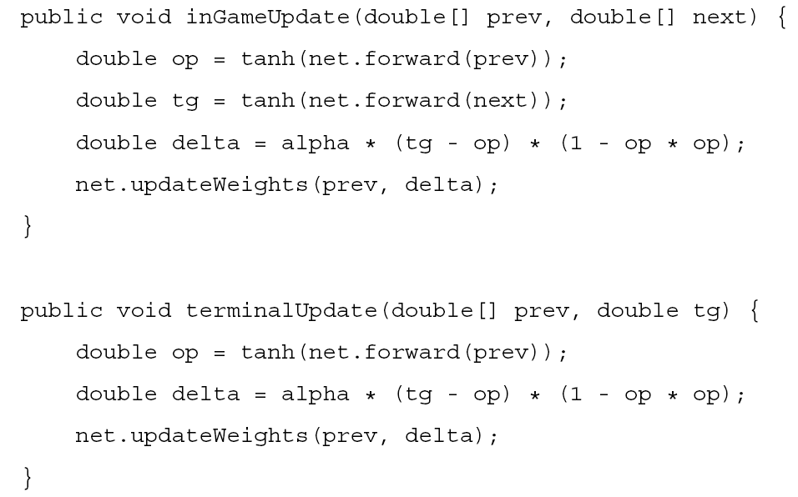
TDL in Java
Notes:
This slide shows the Java implementations of the previous methods.
In each case the delta is calculated, then the method net.updateWeights() is called to
back-propagate the update through the value function given the previous input vector prev.

Slide 43
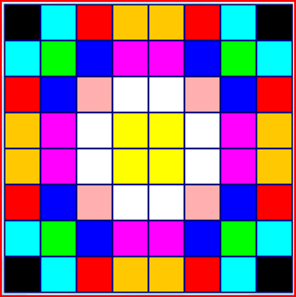
Input Features: Exploit Symmetry
Symmetry speeds up learning
This speeds up learning
Use N-Tuple System for value approximator
[OthelloNTuple]
Notes:
We’ll now see how to achieve much better performance.
There are two techniques we’ll use to achieve this.
One is to enforce symmetry. Many squares in Othello have 8-way symmetry (after rotation
and reflection). By accounting for this in the value function we can reduce the number of
parameters to learn. When we learn something we learn it for all ways it could occur,
and don’t have to learn the same piece of information for when it arises in
different positions.
The other technique is to use an N-Tuple system for the value function.

Slide 44
NTuple Systems
W. Bledsoe and I. Browning. Pattern recognition and reading by machine. In Proceedings of the EJCC, pages 225 232, December 1959.
Sample n-tuples of discrete input space
Map sampled values to memory indexes
Training: adjust values there
Recognition / play: sum over the values
Superfast
Related to:
Kernel trick of SVM (non-linear map to high dimensional space; then linear model)
Kanerva’s sparse memory model
Also similar to Michael Buro’s look-up table for Logistello
Notes:
N-Tuple systems were developed by Bledsoe and Browning as far back as 1959.
The idea is to sample sets of n-tuples of some discrete input space.
Each n-tuple is interpreted as a number based on the current values of the inputs.
In Othello each board square can have three values (black, empty, or white) and
so each n-tuple will be interpreted as a base-3 number.
This is used as an address into a look-up table.
Training consists of adjusting the values contained at each address that is accessed by the current board.
The value function is calculated by summing the values that are addressed by the current board.
This is very fast to compute. The methods is related to …

Slide 45
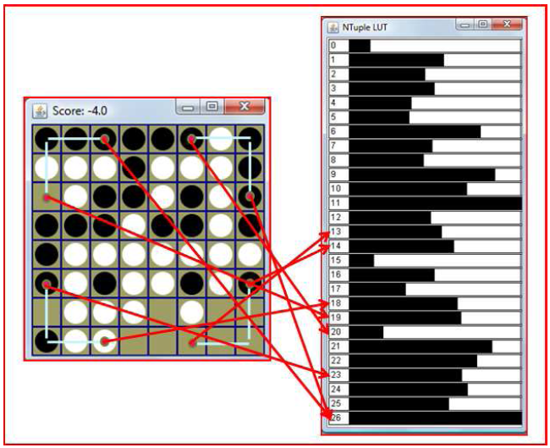
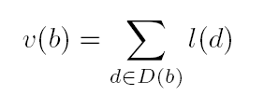
Symmetric 3-tuple Example
Notes:
This slide illustrates the N-Tuple architecture for Othello, showing a single 3-tuple.
Each pale blue line on the board shows one of the eight symmetries for this
particular 3-tuple. Each red line connects an n-tuple sample with it’s address in the look-up table.
There are 27 (3^3) possible values of a 3-digit base-three number, so our lookup table (shown as a bar chart)
has 27 entries in it.
The equation shows the calculation of the value function of the board v(b) as the sum
over all n-tuple values.
d is an address in the look-up table, and l(d) is the value stored at d. D(b) is a function that takes
a board and expands it into the set of addresses for the board, given the set of n-tuples.

Slide 46
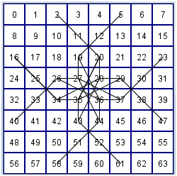
Symmetric N-Tuple Sampling
Notes:
N-tuple sample points were created as snakes by taking random six-step walks around the board, with duplicate squares being deleted from the n-tuple.
This slide shows a single n-tuple snake and it’s eight symmetric versions.

Slide 47

N-Tuple System
Results used 30 random n-tuples
Snakes created by a random 6-step walk
Duplicate squares deleted
System typically has around 15000 weights
Simple training rule:
Notes:
30 of these random n-tuple snakes were used, which led to a system with around 15,000 weights.
The training rule for the system is very simple. Having calculated the standard TDL delta term as
shown previously, we simply add this delta term to the value stored at each address in the table accessed
by the previous board, as indicated in the equation.

Slide 48
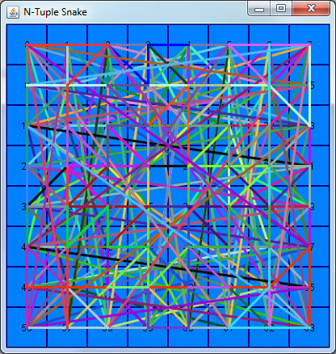
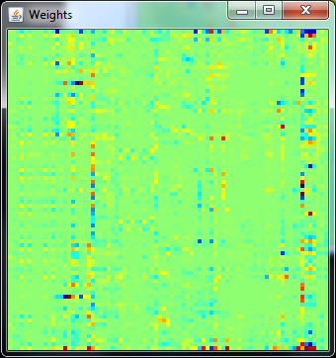
Champion Evolved N-Tuple (Demo)
Hybrid approach
Structure evolved
Weights set by TDL
Or by preference learning

Slide 49
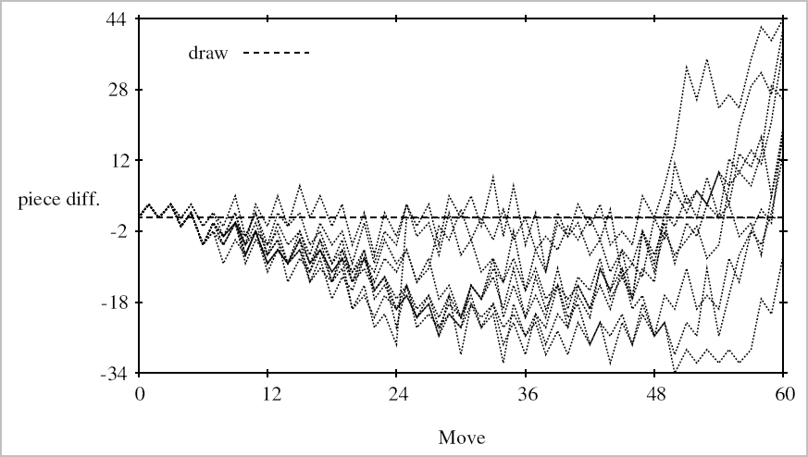
Typical Learned strategy… (N-Tuple player is +ve – 10 sample games shown)
Notes:
This graph plots the piece-difference trajectory of 10 games where the
self-trained N-Tuple player played a standard heuristic player.
Most of the time the N-Tuple player seems behind during the mid-game but comes
back strongly at the end to win. As mentioned previously, this is a common way in
which a stronger player defeats a weaker player.

Slide 50
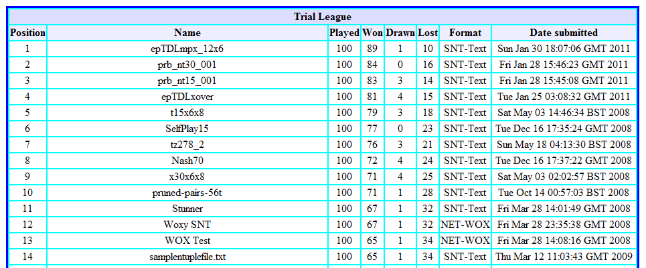
Web-based League (Jan 30th 2011) All Leading entries are N-Tuple based
Notes:
Here we see a snapshot of a web-based Othello value function league that I’ve been
running for several years now. Anyone can supply a value function to compete
against other value functions in the same game-engine running at 1-ply.
The league shows that all the top players are based on N-Tuple systems (this may
not be obvious from the names but the type of each player is stored on the server).
The second best class of player are spatially arranged MLPs in the style of
the Blondie24 checkers player, followed by standard MLPs, and then weighted piece counters.
This clearly shows that the choice of value function has a profound effect on performance.

Slide 51
N-Tuple Summary
Outstanding results compared to other game-learning architectures such as MLP
May involve a very large number of parameters
Temporal difference learning can learn these effectively
But co-evolution fails (results not shown in this presentation)
Further reading: [OthelloNTuple]
Notes:
N-Tuple systems offer outstanding results compared to other game-learning architectures such as MLPs
and weighted piece counters.
They may involve a very large number of parameters – the trained player had around 15,000 weights,
but temporal difference learning can learn these effectively.
In a separate experiment not shown here co-evolution failed to train
this type of architecture, partly due to the lower information rates
as explained previously.

Slide 52
Important Future Directions
New co-evolutionary algorithms that mine complete game histories
TDL applied to:
Maximise information rates
Exploit good choice of function approximator
Hybrid TDL / Evolutionary Algorithms
Integrated with Monte Carlo Tree Search
Thoroughly investigate “incidental choices”
E.g. how board is presented to learner
This can have a very significant effect

Slide 53
Summary
All choices need careful investigation
Big impact on performance
Function approximator
N-Tuples and interpolated tables: very promising
Table-based typically learns better than MLPs with TDL
Learning algorithm
TDL is often better for large numbers of parameters
But TDL may perform poorly with MLPs
Evolution is easier to apply
Learning to play games is hard but fascinating!
– much more research needed

Slide 54
References-I
[TDGammon] G. Tesauro, Temporal difference learning and TD-gammon, Communications of the ACM, vol. 38, no. 3, pp. 58 – 68, 1995.
[Neuro-Gammon] J. Pollack and A. Blair, Co-evolution in the successful learning of backgammon strategy, Machine Learning, vol. 32, pp. 225 – 240, 1998.
[Blondie] K. Chellapilla and D. Fogel, Evolving neural networks to play checkers without expert knowledge, IEEE Transactions on Neural Networks, vol. 10, no. 6, pp. 1382 – 1391, 1999.

Slide 55
References-II
[Menace] D. Michie, Trial and error, In Science Survey, part 2, Penguin, 1961, pp. 129 – 145.
[NERO] Kenneth O. Stanley, Bobby D. Bryant, Risto Miikkulainen, Real-Time Evolution in the NERO Video Game, Proceedings of IEEE CIG 2005
[RL] R. Sutton and A. Barto, Introduction to Reinforcement Learning, MIT Press, 1998.

Slide 56
References-III
[CMA-ES] Nikolaus Hansen, The CMA Evolution Strategy: A Tutorial, April 26 2008 URL : http://www.bionik.tu-berlin.de/user/niko/cmatutorial.pdf
[InfoRates] Simon M. Lucas, Investigating Learning Rates for Evolution and Temporal Difference Learning, IEEE Computational Intelligence and Games (2008)
[InterpolatedTables] Simon M. Lucas, Temporal Difference Learning with Interpolated Table Value Functions, IEEE Computational Intelligence and Games (2009)
[CoevTDLOthello] Simon M. Lucas and Thomas P. Runarsson, Temporal Difference Learning Versus Co-Evolution for Acquiring Othello Position Evaluation, IEEE Symposium on Computational Intelligence and Games (2006)
[OthelloNTuple] Simon M. Lucas, Learning to Play Othello with N-Tuple Systems, Australian Journal of Intelligent Information Processing (2008), v. 4, pages: 1 - 20

Slide 57
References-IV
[COEV-INTRANSITIVITIES] Samothrakis, S.; Lucas, S.; Runarsson, T.P.; Robles, D., Coevolving Game-Playing Agents: Measuring Performance and Intransitivities, Evolutionary Computation, IEEE Transactions on , vol.17, no.2, pp.213,226, April 2013
[PREF-LEARNING-GAMES] Runarsson, T.P.; Lucas, S.M., Imitating play from game trajectories: Temporal difference learning versus preference learning, Computational Intelligence and Games (CIG), 2012 IEEE Conference on , vol., no., pp.79,82, 11-14 Sept. 2012

